Slide 1
SORTE_G getting started guide
Thomas Mauer, Factory Automation and Control, SEM
1/4/2023

Slide 2
Tool installations
Code Composer Studio 12.0.0.00009 [link]
MCU+ SDK for AM243x 8.3.0.18 [link]
SysConfig 1.13.0 [link]
PRU compiler TI v2.3.2 within CCS [see instruction on next PPT]

Slide 3
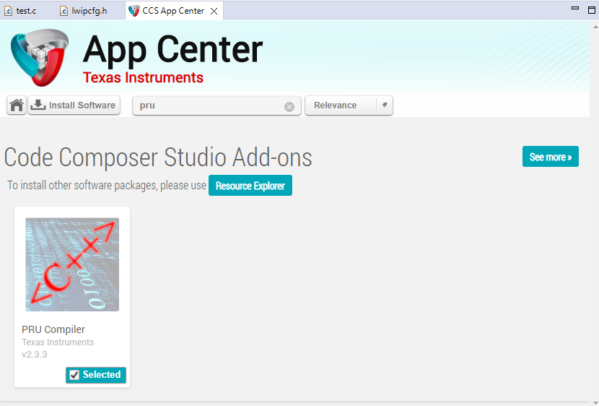
PRU compiler installation
Install PRU compiler within CCS.
Select View->App Center
Enter pru in the search window
Select PRU Compiler checkbox.
Press Install Software and follow the installation procedure
Restart CCS when asked.

Slide 4
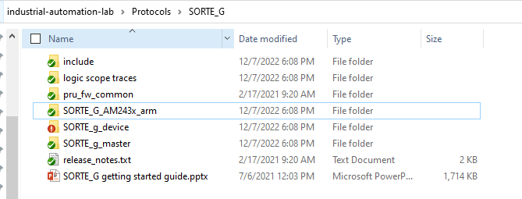

Import the projects to CCS
Extract the SORTE_G projects onto your hard disk.
Best practice: Use a path that has no “white spaces” in any name or subdirectories.
E.g. C:\ti\industrial-automation-lab\Protocols\SORTE_G
Import the three projects into CCS

Slide 5
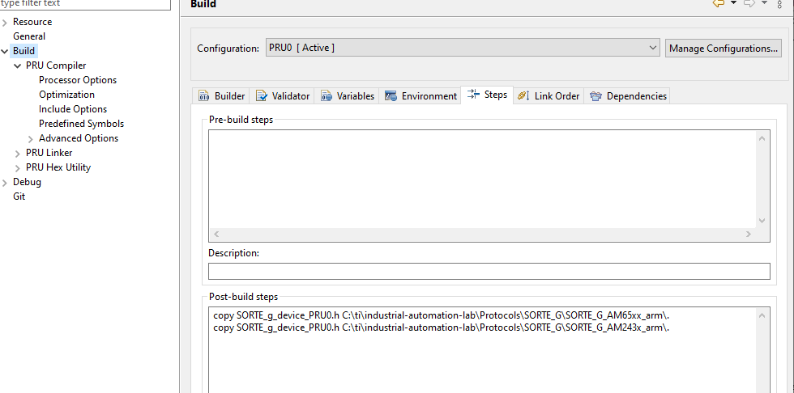
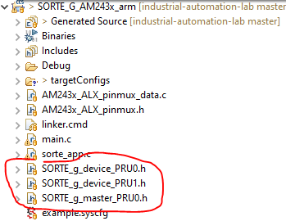
SORTE_G device and SORTE_G master
Configure the SORTE_G arm folder. This will copy the PRU c-header files to the ARM project, after successful compilation
Open project properties, Build, Steps
Set the path correct path to the ARM base project.
Do this for the SORTE_G device and for the SORTE_G master projects individually.
Alternative, you can also copy the PRU firmware files manually from the SORTE_G device and SORTE_G master Debug folder into the SORTE_G ARM243x ARM folder

Slide 6
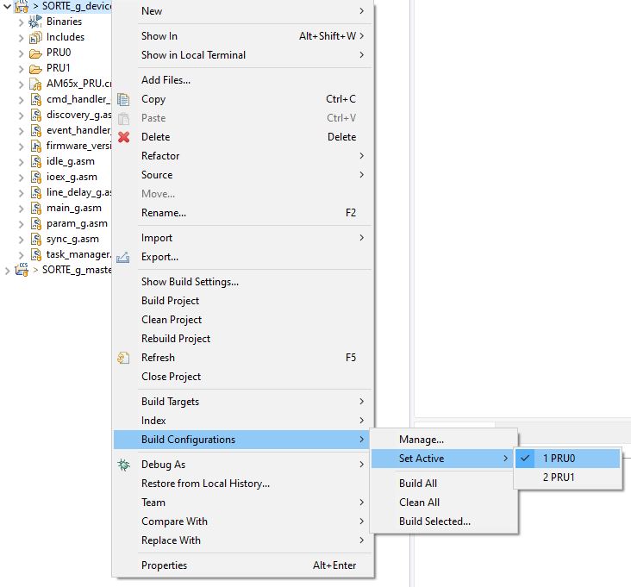
SORTE_G device
SORTE_G device source code uses the same code base for PRU0 and PRU1. The source code contains individual PRU configuration by use of “.if $defined (PRU0)” and “.else”.
Therefore, the SORTE_G device code must be build for PRU0 and PRU1 by executing the following steps.
Right click project, select Build Configuration, Set Active, and PRU0
Rebuild project
Right click project, select Build Configuration, Set Active, and PRU1
Rebuild projects

Slide 7
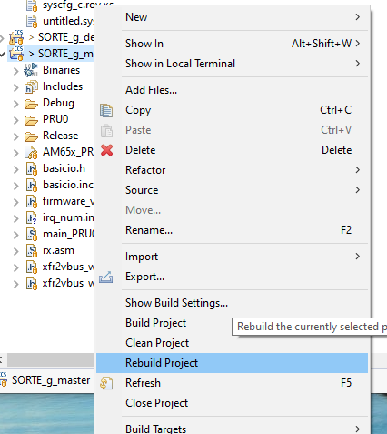
SORTE_G master
Rebuild project

Slide 8
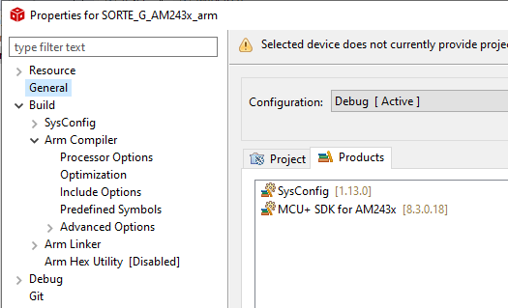
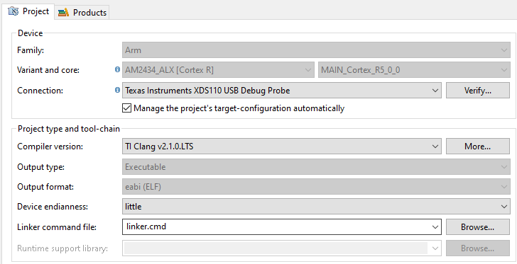
SORTE_G AM243x ARM R5F project
Check the SysConfig and MCU+ SDK for AM243x version within project properties, General.
Re-build the project

Slide 9
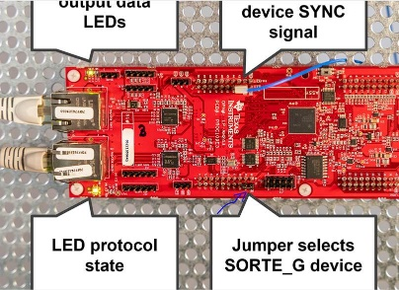
Flashing SORTE_G to AM243x_LP
Flashing SORTE_G demo on the AM243x Launch Pads:
Flash SOC Initialization Binary as described here (I am not sure if this step is really needed for the demo, but it is needed if we want to access the device with CCS). https://software-dl.ti.com/mcu-plus-sdk/esd/AM243X/08_05_00_24/exports/docs/api_guide_am243x/EVM_SETUP_PAGE.html#EVM_FLASH_SOC_INIT
Flash the SORTE_G binary as described here. Please adopt the script/sequence so that it flashes the provided SORTE_G binary. There is only a single binary for controller and device. Controller or device function is selected via a jumper (see step 4) https://software-dl.ti.com/mcu-plus-sdk/esd/AM243X/08_05_00_24/exports/docs/api_guide_am243x/TOOLS_FLASH.html#TOOLS_FLASH_UART_UNIFLASH
After the flash process, re-configure the bootmode switches. Once the application starts, there are SORTE_G specific UART outputs on serial console. https://software-dl.ti.com/mcu-plus-sdk/esd/AM243X/08_05_00_24/exports/docs/api_guide_am243x/GETTING_STARTED_FLASH.html#autotoc_md49

Slide 10
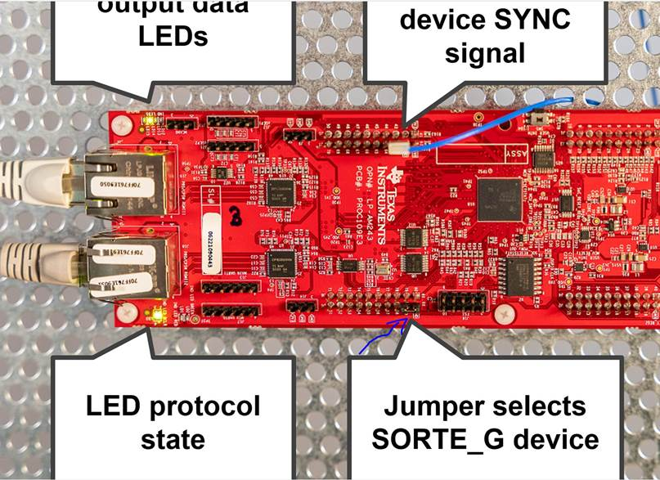
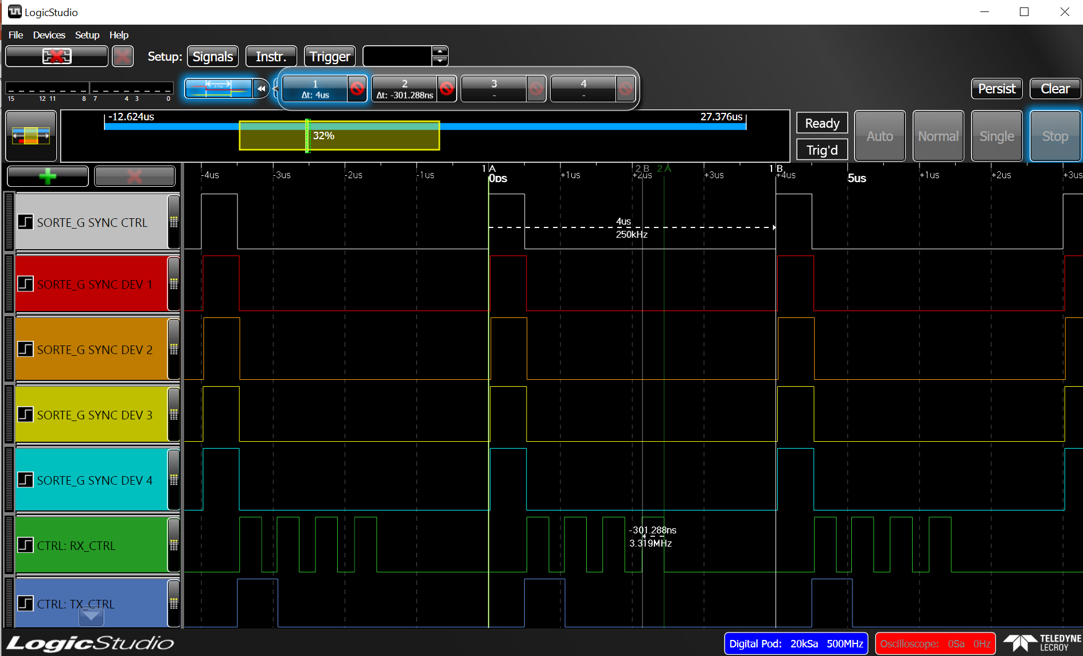
Starting SORTE_G demo
Before power up, select if the AM243x_LP should operate as controller or device
Set jumper on each AM243x_LP for selecting SORTE_G device: J6, pin 60-59 Remove jumper on AM243x_LP for selecting SORTE_G controller: J6, pin 60-59
SYNC signal can be accessed on J7, pin 63. This signal is supported by controller and devices. Mentoring this with (logic) scope shows the time synchronization.

Slide 11
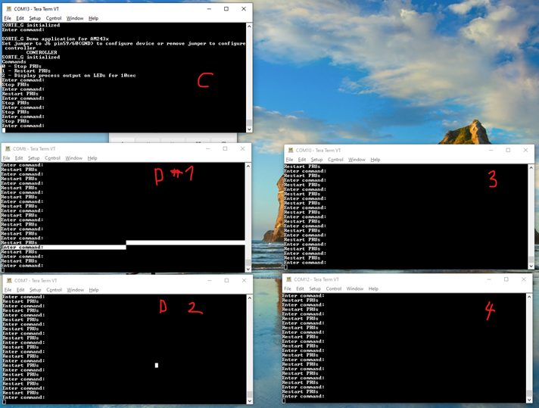
Starting SORTE_G demo cont’d
Use UART terminal to interface to each device and to controller (see below snapshot of my system with one controller and 4 devices).
press ‘1’ does restart the PRUs firmware
press ‘0’ does stop PRU firmware
Each device output a different blinking LED pattern speed
The Controller shows the same blinking LED pattern as the first device (as all devices relay/send back the payload they are getting)
Recommended procedure to get in IO Exchange state:
Stop the Controller (press 0)
Start all the devices and make sure they have a Ethernet link. Eventually press ‘1’ to restart them
Once all device are ready, then only start he controller (press 1).
To restart the system or to recover the system
Stop the Controller (press 0)
Restart all devices (press 1)
Start the controller (press 1)

